Slide 1
Brownbag

Slide 3
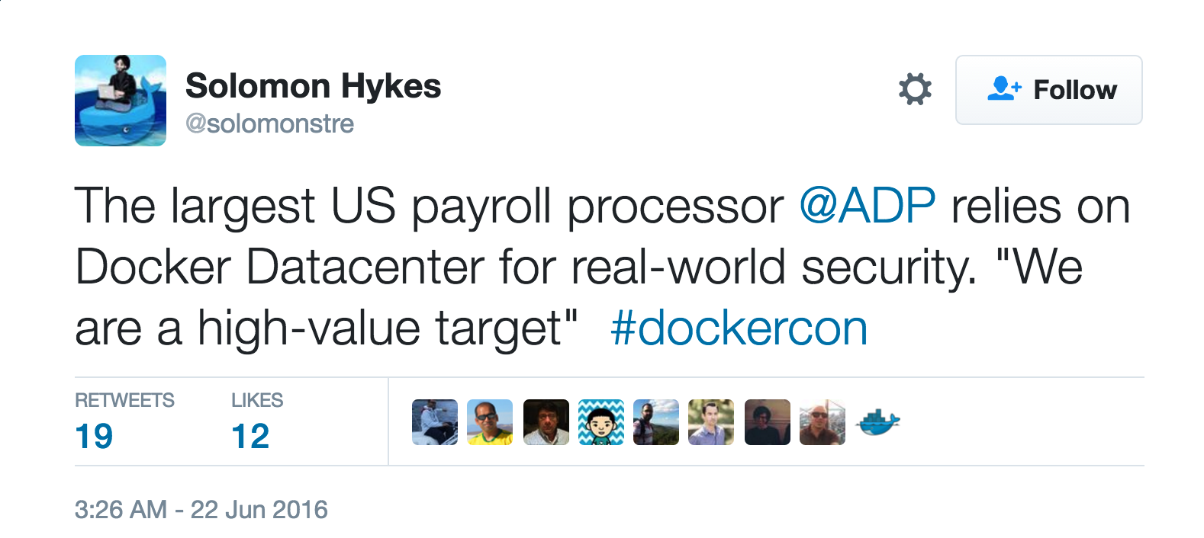
Security?

Slide 6
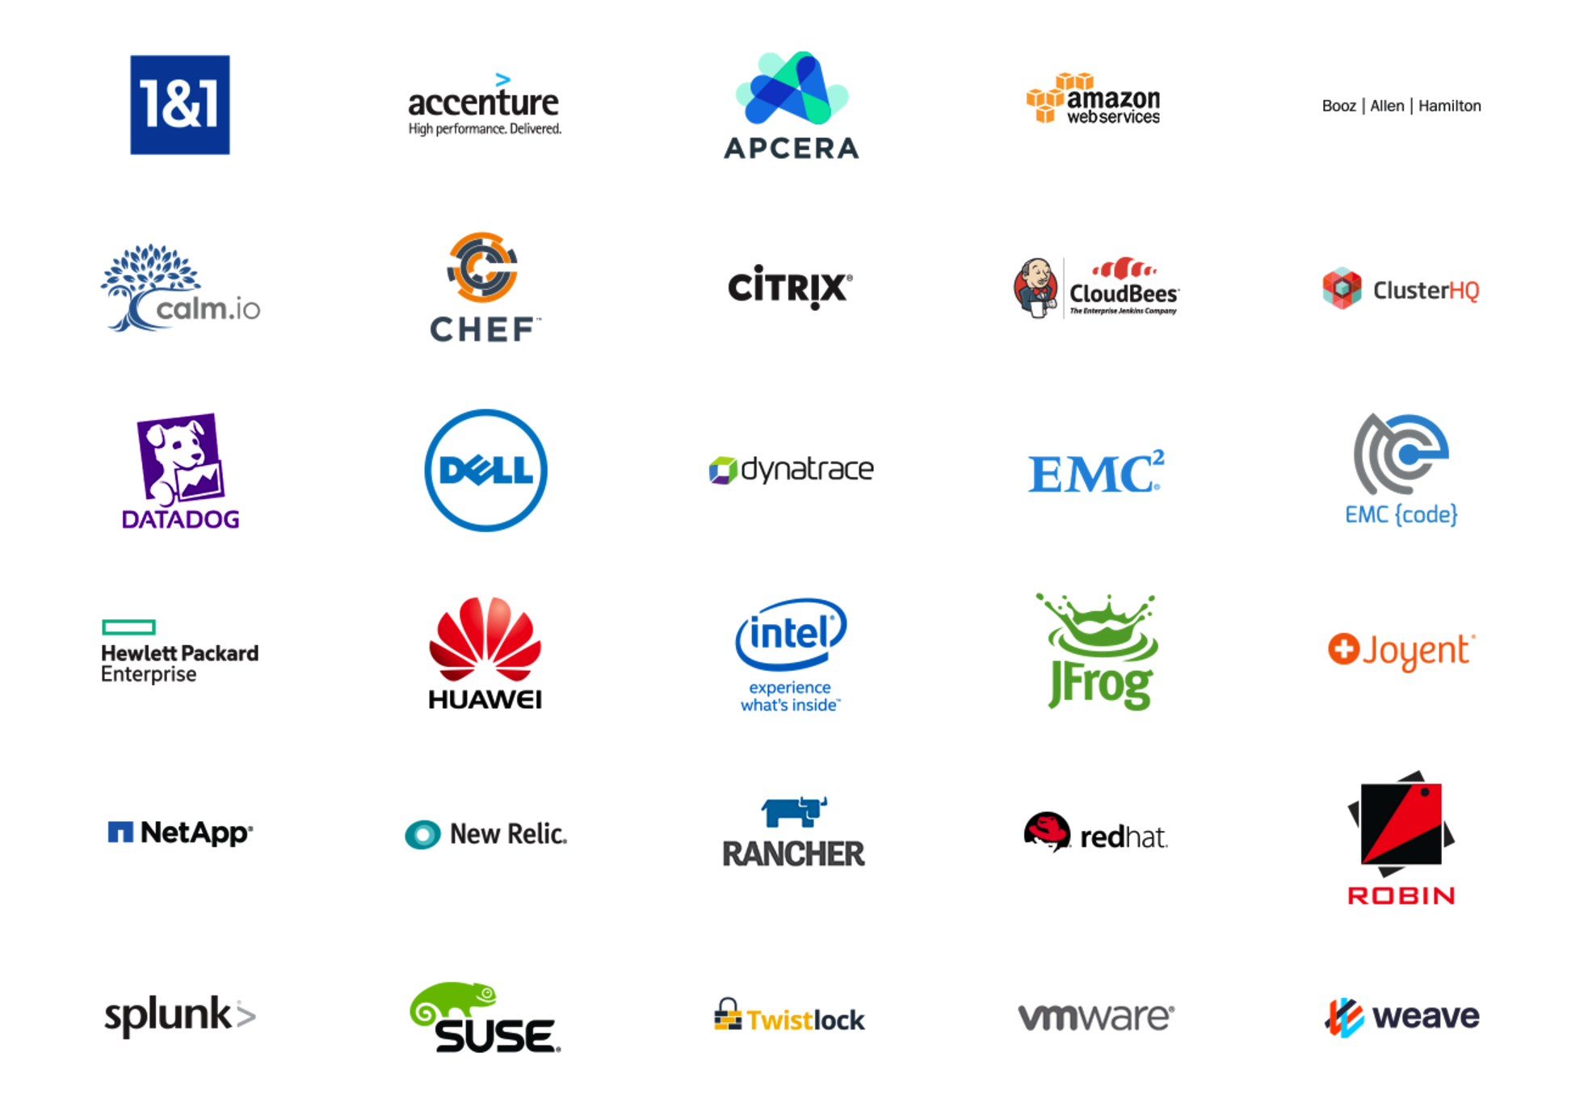
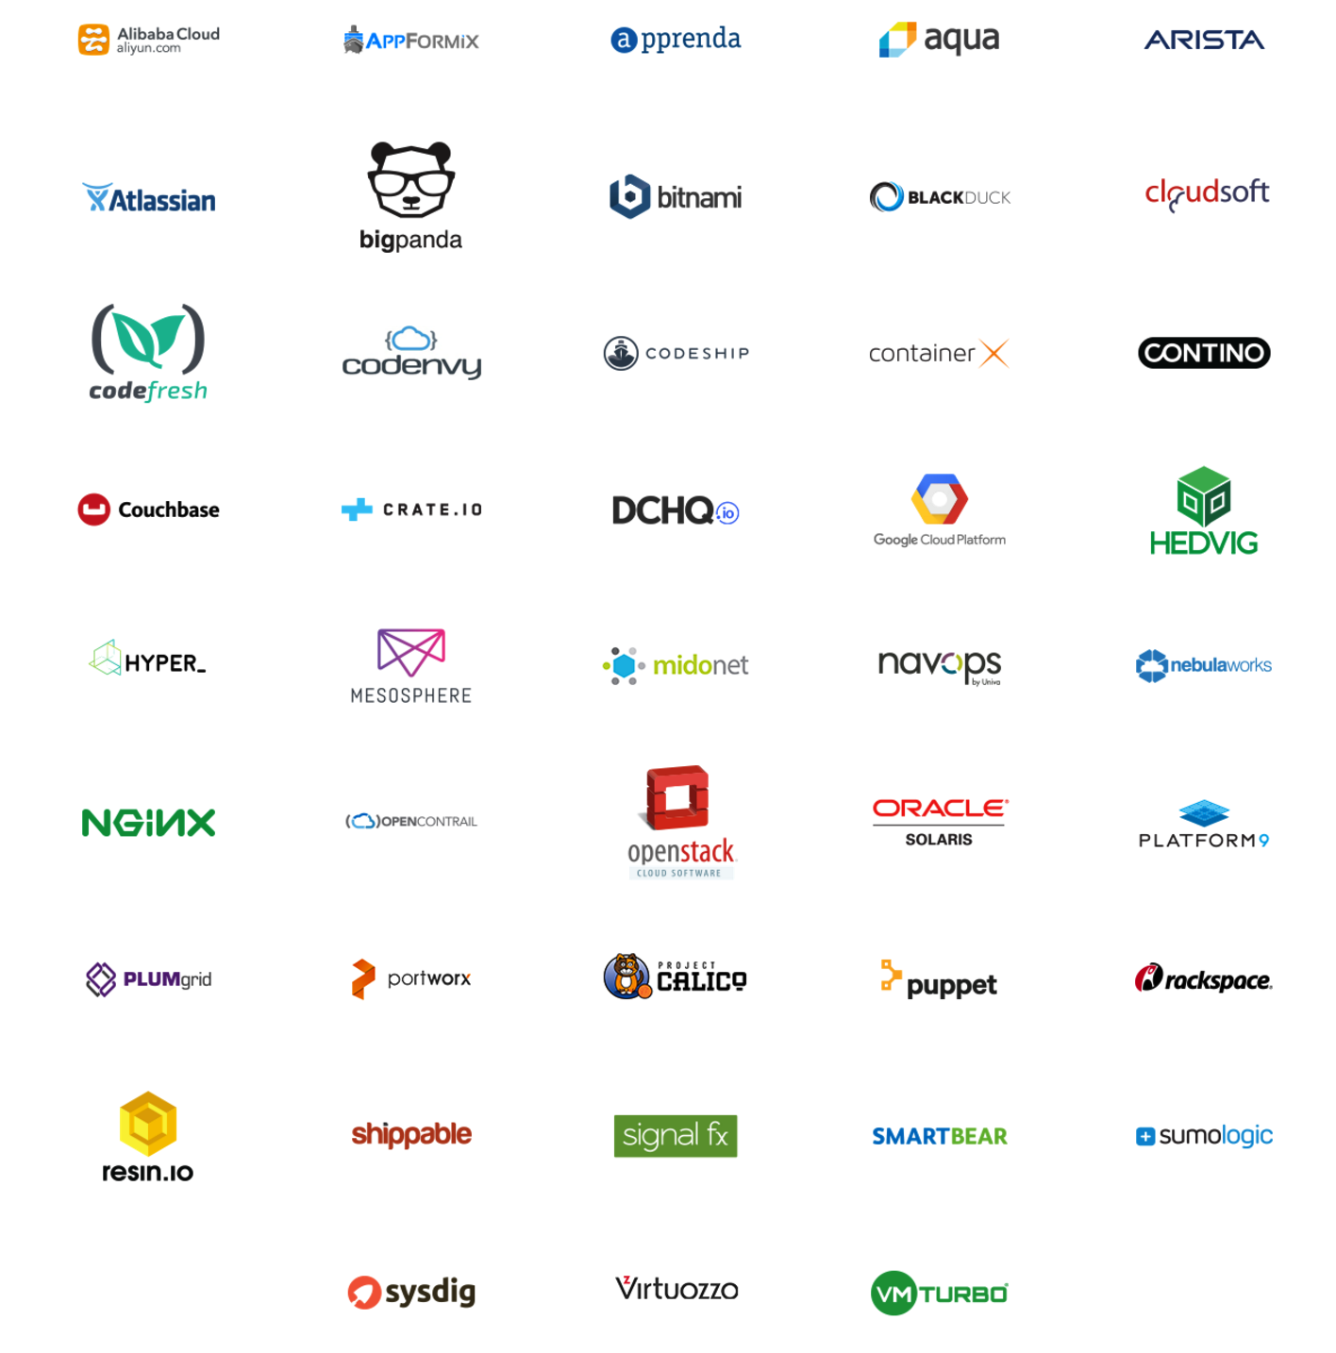
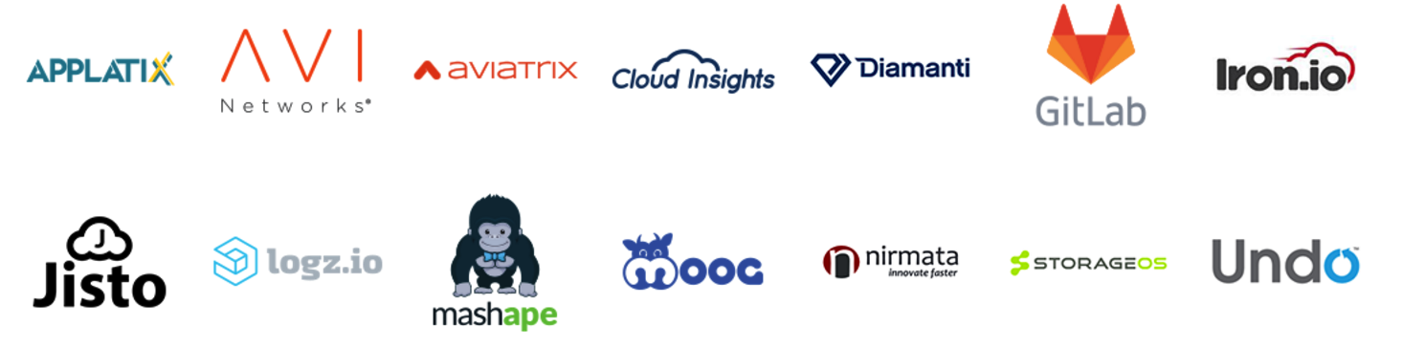
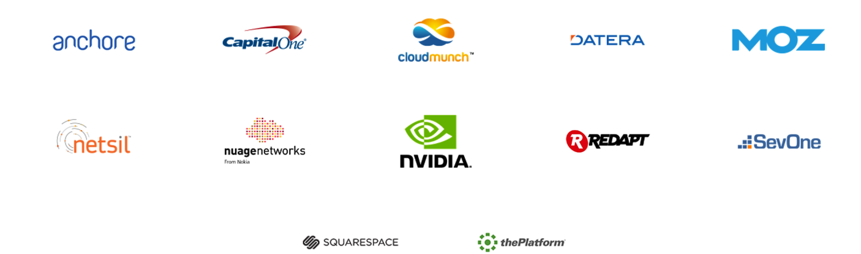


Ecosystem

Slide 7
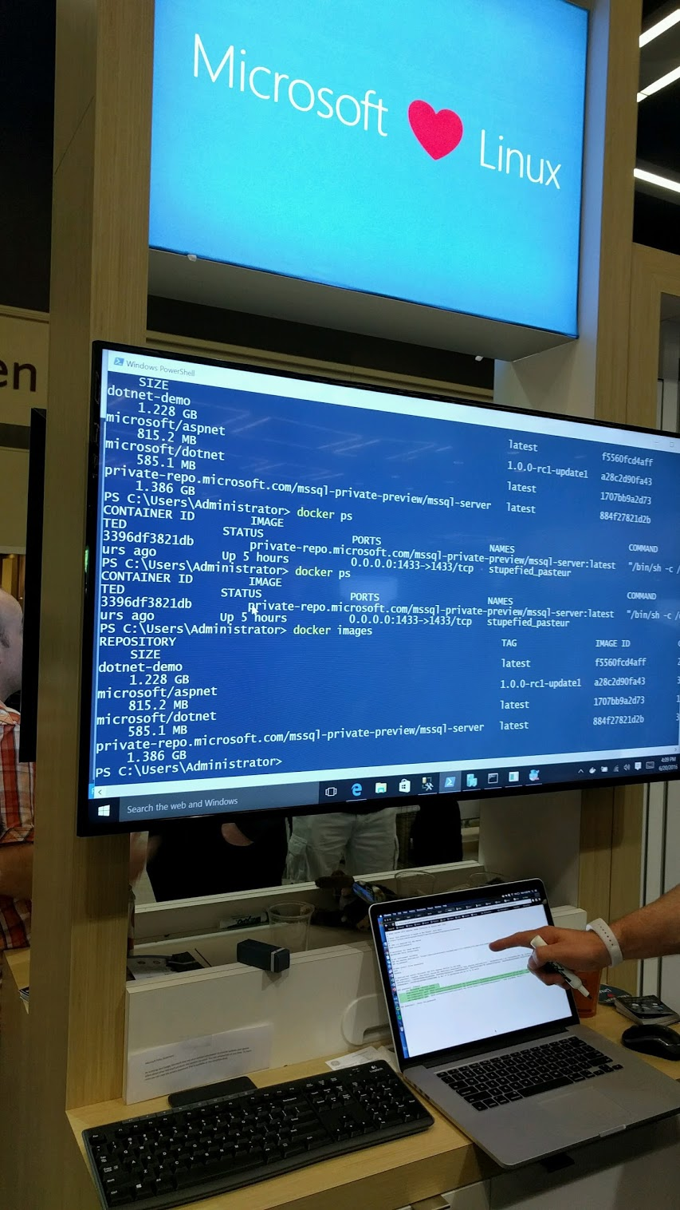
Microsoft in Split Personality

Slide 10
Developer experience is the key.

Slide 11
Demo
https://www.youtube.com/watch?time_continue=2091&v=vE1iDPx6-Ok

Slide 18
Open source
https://github.com/docker/swarmkit

Slide 19
Demo: Docker for AWS
https://www.youtube.com/watch?v=c-EHuF-e3oY

Slide 20
Distributed Application Bundles (DAB)
Dockerfile -> Docker Image
docker-compose.yml -> DAB

Slide 21
Docker Daemon = containerd + runc
https://github.com/docker/containerd
https://github.com/opencontainers/runc
containerd does NOT manage processes inside containers.
For that you still need tini or dumb-init
https://github.com/krallin/tini
https://github.com/Yelp/dumb-init

Slide 22
IoT
resin.io: Multi-architecture Delivery Pipeline https://resin.io/
No downtime deploy on a drone https://www.youtube.com/watch?v=75vm6rRb6K0
Run a Docker Swarm on Raspbarry Pis http://blog.alexellis.io/iot-docker-cluster/

Slide 23
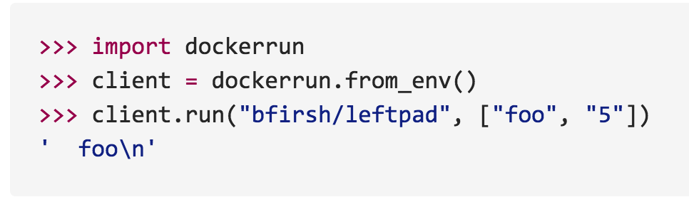
Serverless
https://github.com/bfirsh/serverless-docker
AWS Lambda executes function in a container

Slide 24
Innovation = Survival

Slide 25
Innovation = Survival
Resolve conflict/competition by moving forward, not by attacking or conservative. Be open minded and show the world why you are better.
Do it, not just talk about it. Instead of complaining a technology, why don't you contribute to it? Or create a better one?
Your ability is only bound by imagination.

Slide 26
Questions? Comments?

